Slide 1

COMP90050
Advanced Database Systems
Semester 2, 2024
Lecturer: Farhana Choudhury (PhD)
Live lecture – Week 8

Slide 2
Presentation details
Announcement
Register asap
Check FAQs

Slide 3
Core Concepts of Database management system
Efficiency
Database performance metrics
Hardware
Software/ DB tuning
Efficiency/speed
Effectiveness
Effectiveness
Concurrent users
Security & Reliability
Transactions
Reactive
Reliability
Crash recovery
Preemptive
Fault tolerance
Hardware:
Arrangement of multiple disks
Voting among multiple disks/modules for reliability
Communication reliability
Data duplication

Slide 4
Fault Tolerance
The property that enables a system to continue operating properly in the event of the failure of some of its components.
We have covered
Statistics crash course
Lifecycle of a system
Different fault tolerance techniques
Communication reliability

Slide 5
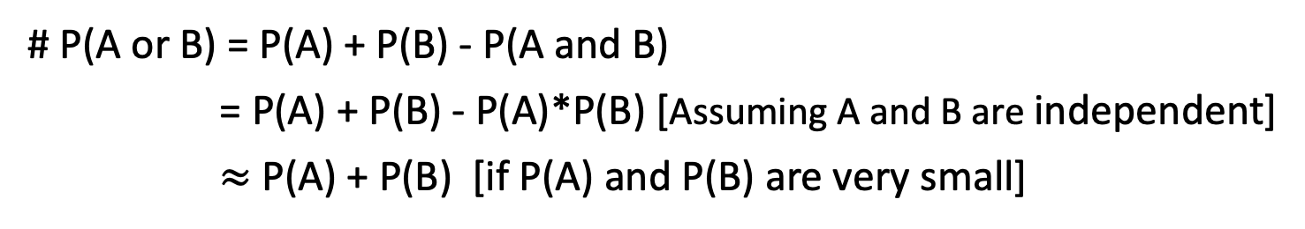
# P(A and B) = P(A)*P(B) assuming A and B are independent events.
# P(A or B) = P(A) + P(B) - P(A and B)
= P(A) + P(B) - P(A)*P(B) [Assuming A and B are independent]
$≈$ P(A) + P(B) [if P(A) and P(B) are very small]
This is not a math subject!
Understanding the concepts (e.g., the event that both disks fail at the same time is statistically ‘how much’ less likely than a single disk fail)

Slide 6
Fault tolerance by RAID
Redundant Array of Independent Disks – different ways to combine multiple disks as a unit for fault tolerance or performance improvement, or both of a database system
Choosing the suitable RAID level
The factors to consider:
Reliability
Performance
Storage utilization
Price/number of disks
Additional overhead?

Slide 7
Example summary: RAID 0 and RAID 2
A0
A1
b0
b1
A2
A3
b2
b3
A4
A5
b4
b5
A6
A7
b6
b7
Storage utilization?
Block level striping
Bit level striping (rare)
Number of disks needed?
Provides balanced I/O of disk drives
Provides higher throughput (~doubles)
Any disk failure will be catastrophic
MTTF reduces by a factor of 2
Higher throughput at the cost of increased vulnerability to failures
Overhead difference?
Calculation of MTTF values – in tutorials
Notes:
alternative

Slide 8
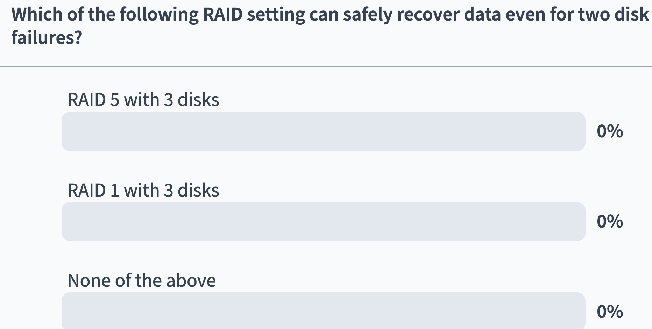

RAID – exercise
Time for a poll - Pollev.com/farhanachoud585
Notes:
alternative

Slide 9

Fault Tolerance by voting
Use more than one module, voting for higher reliability
Failvote - Stops if there are no majority agreement
Failfast (voting)- Similar to failvote except the system senses which modules are available and uses the majority of the available modules.
Supermodule – A system with multiple modules that use voting when multiple modules are working/available, but still work even when only one is available
100
100
1

Slide 10
Fault Tolerance by voting
In a Failfast system, which of the following cases we can accept an action?
Total number of devices | No. of working devices | No. of agreeing devices | Accept?
10 | 6 | 4
10 | 6 | 3
10 | 5 | 3
5 | 5 | 3
5 | 4 | 2
5 | 2 | 2
5 | 1 | -

Slide 11
Fault Tolerance by voting
In a Failfast system, which of the following cases we can accept an action?
Total number of devices | No. of working devices | No. of agreeing devices | Accept?
10 | 6 | 4 | y
10 | 6 | 3 | n
10 | 5 | 3 | y
5 | 5 | 3 | y
5 | 4 | 2 | n
5 | 2 | 2 | y
5 | 1 | - | n

Slide 12
Communication reliability
- Why important for databases?

Slide 13


Communication reliability
I will tell a story
Once upon a time…
Ack
Ack

Slide 14
Communication reliability
If acknowledgement not received -
I will tell a story
I will tell a story
I will tell a story

Slide 15
Core Concepts of Database management system
Efficiency
Database performance metrics
Hardware
Software/ DB tuning
Efficiency/speed
Effectiveness
Effectiveness
Concurrent users
Security & Reliability
Transactions
Reliability
Crash recovery
Fault tolerance
Preemptive
Data duplication

